Slide 1
ED5330 Control of Automotive Systems
Project 2: Hydraulic Hitch Control In Tractors

Slide 2
System Description
Electronically controlled hydraulic system.
Used to lift or lower the load attached to the vehicle through a mechanical linkage.
Oscillations of the load due to external disturbance causes pitching vibrations in the vehicle.
The frequency of vibrations is between 1 Hz and 5 Hz.
Objective:
To attenuate the pitching vibrations of the vehicle by lifting or lowering the load in accordance with the disturbance force.
i(t)
Valve
q(t)
Cylinder
p(t)
Mechanical Linkage
f(t)
i(t)
Plant
Δf(t)
Since the objective is only to attenuate the additional force due to disturbances, change in force (Δf(t)) is considered to be the plant output.

Slide 3
Procedure
Frequency Response Analysis
LTI check
Step Response Analysis
Model Parameters
Controller Design
Lag compensation

Slide 4
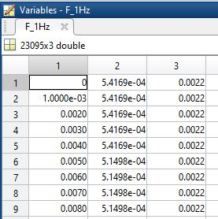
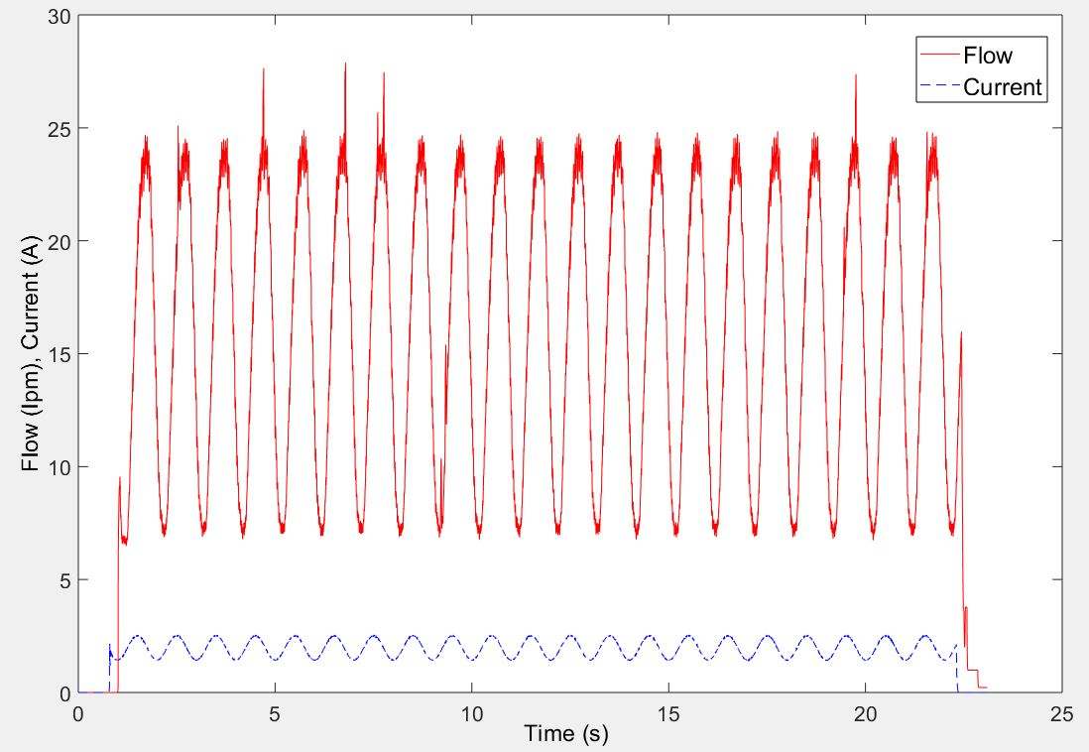
Frequency response
freq.mat
Each matrix contains Time, Current and Flow data.
Frequency
Time
Current
Flow
Plot input and output vs time.

Slide 5
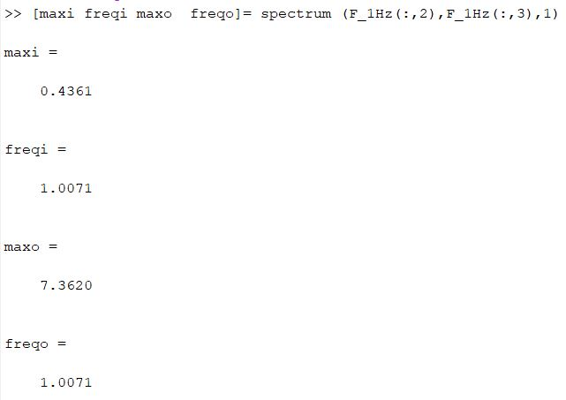
Identify the dominant frequency in each input and output pair.
Make a stem plot of magnitude vs frequency for both input and output.
Check if the system can be approximated to be an LTI system.

Slide 6
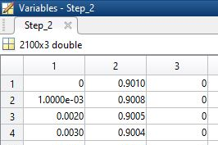
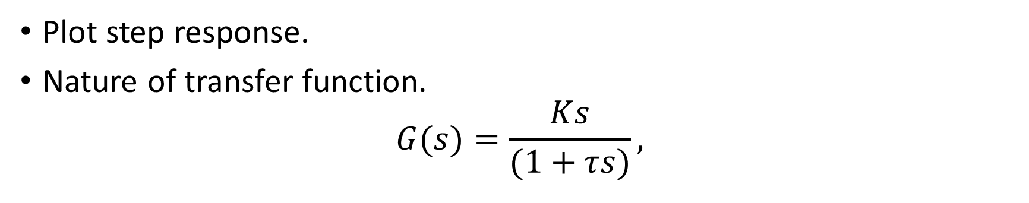
Step Response Analysis
Step response data (time.mat)
Time
Δf
Current
Plot step response.
Nature of transfer function.
$$G(s)=\frac{Ks}{(1+τs)},$$

Slide 7
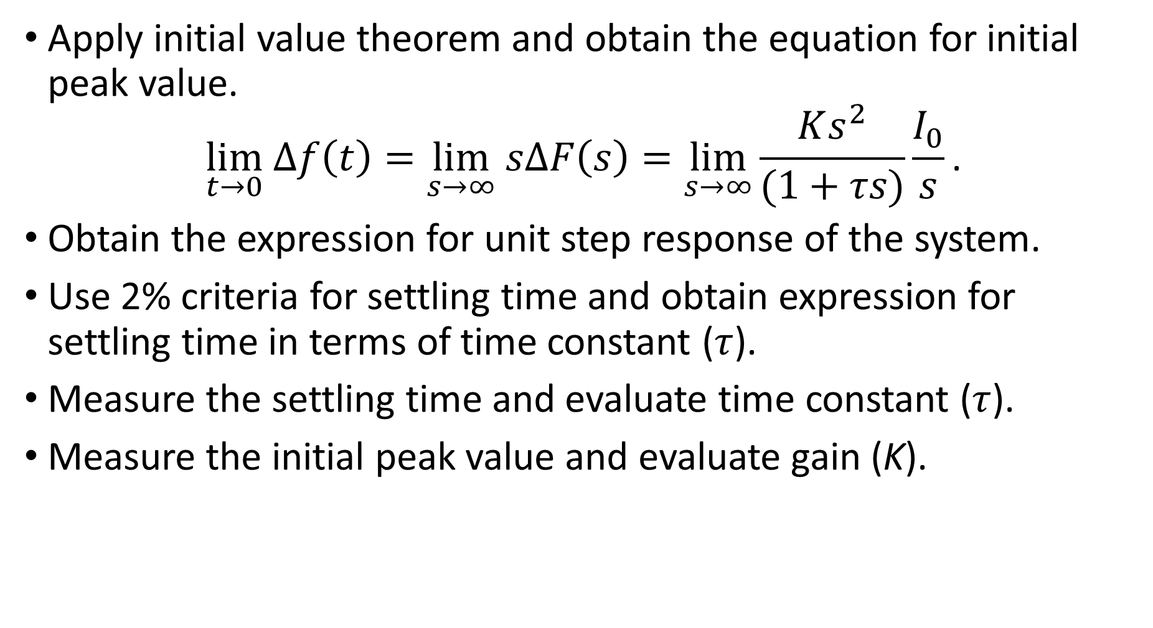
Apply initial value theorem and obtain the equation for initial peak value.
$$\lim_{t→0} Δf\left(t\right)=\lim_{s→∞} sΔF\left(s\right)=\lim_{s→∞}\frac{Ks^{2}}{(1+τs)}\frac{I_{0}}{s}\text{.}$$
Obtain the expression for unit step response of the system.
Use 2% criteria for settling time and obtain expression for settling time in terms of time constant ($τ$).
Measure the settling time and evaluate time constant ($τ$).
Measure the initial peak value and evaluate gain (K).

Slide 8
Obtain four sets of transfer function parameters from four data sets given.
Design a lag compensator for each transfer function.
Adopt a suitable method for comparison and select a lag compensator which performs the best with all four transfer functions with proper reasoning.

Slide 9
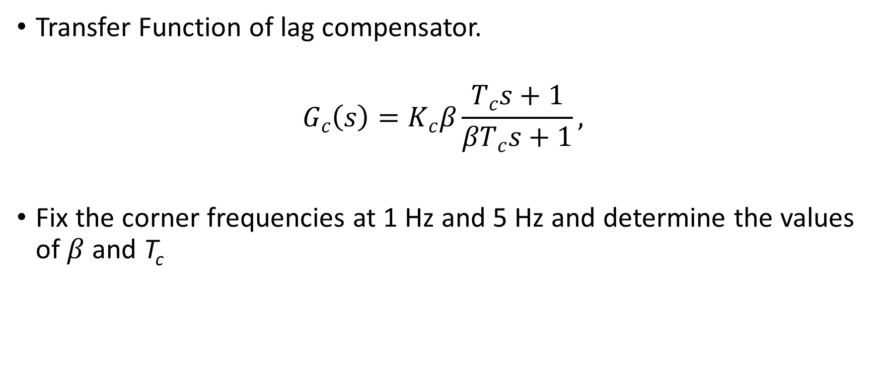
Lag Compensator Design
Transfer Function of lag compensator.
$$G_{c}\left(s\right)=K_{c}β\frac{T_{c}s+1}{βT_{c}s+1},$$
Fix the corner frequencies at 1 Hz and 5 Hz and determine the values of $β$ and T_{c}

Slide 10
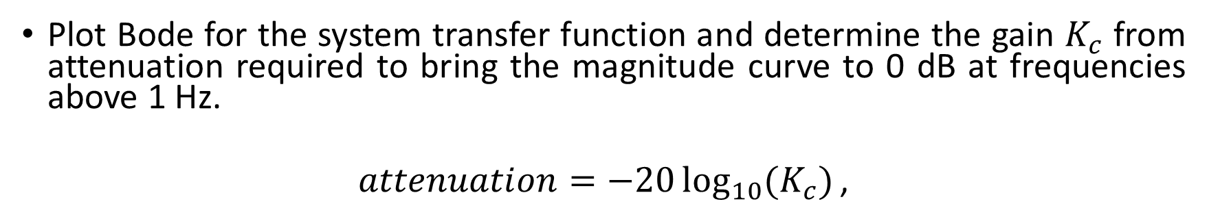
Plot Bode for the system transfer function and determine the gain $K_{c}$ from attenuation required to bring the magnitude curve to 0 dB at frequencies above 1 Hz.
$$attenuation=−20\log_{10}{(K_{c})}\text{,}$$
0
Frequency (rad/s)

Slide 11
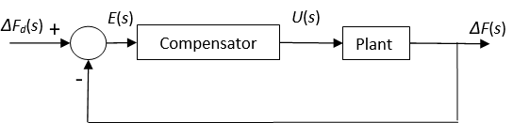
Generate a disturbance signal consisting of sinusoidal (1Hz and 4 Hz) , step and ramp signals of magnitude 2500 N.
Closed loop simulation on Simulink.
Disturbance
+
Tune the compensator gain so that the controller output does not exceed 2.3 A.
Calculate the percentage of attenuation achieved.

Slide 12
Thank You

